Slide 1

Project 1-2: Examples
EL2001: Mathematical Foundation of Computer Science
Notes:
Today’s title is the overview of running programs in computer systems.

Slide 2
Goal
You are going to understand how to exchange messages between Alice and Bob
Simple networking
JavaScript Object Notation (JSON)
Base64
Advanced Encryption Standard (AES)
Please download source code from:
https://github.com/hw5773/math-project-2026
You can do it by “git clone https://github.com/hw5773/math-project-2026” on your terminal

Slide 3
Networking
We will run simple Alice-Bob communications written in Python
1. Run the simple Alice-Bob applications on your local machine
Please open two terminals (one for Alice, the other for Bob):
#> cd example
On the Bob terminal: run the Bob application
#> python3 network_bob.py --port <port number> (--addr 0.0.0.0)
ex) python3 network_bob.py --port 5555
On the Alice terminal: run the Alice application
#> python3 network_alice.py --addr 127.0.0.1 --port <port number>
ex) python3 network_alice.py --addr 127.0.0.1 --port 5555
Notes:
We are living in the computerized world. Now we cannot imagine the world without computers.

Slide 4
Networking
We will run simple Alice-Bob communications written in Python
2. Run the simple Alice-Bob applications between two machines
Please do the following example with your friend:
On the Bob computer: run the Bob application
#> python3 network_bob.py --port <port number> (--addr 0.0.0.0)
ex) python3 network_bob.py --port 5555
On the Alice computer: run the Alice application
#> python3 network_alice.py --addr <Bob’s IP address> --port <port number>
ex) python3 network_alice.py --addr 10.1.3.2 --port 5555
Notes:
We are living in the computerized world. Now we cannot imagine the world without computers.

Slide 5
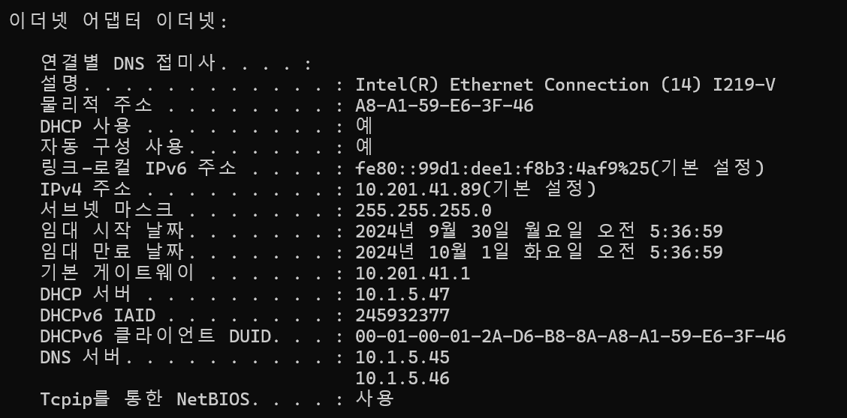
Networking
How to find Bob’s IP address:
On the Bob’s computer, please do the following:
On the Vscode terminal:
#> ifconfig
On the Windows command (명령프롬프트):
#> ipconfig /all
Notes:
We are living in the computerized world. Now we cannot imagine the world without computers.

Slide 6
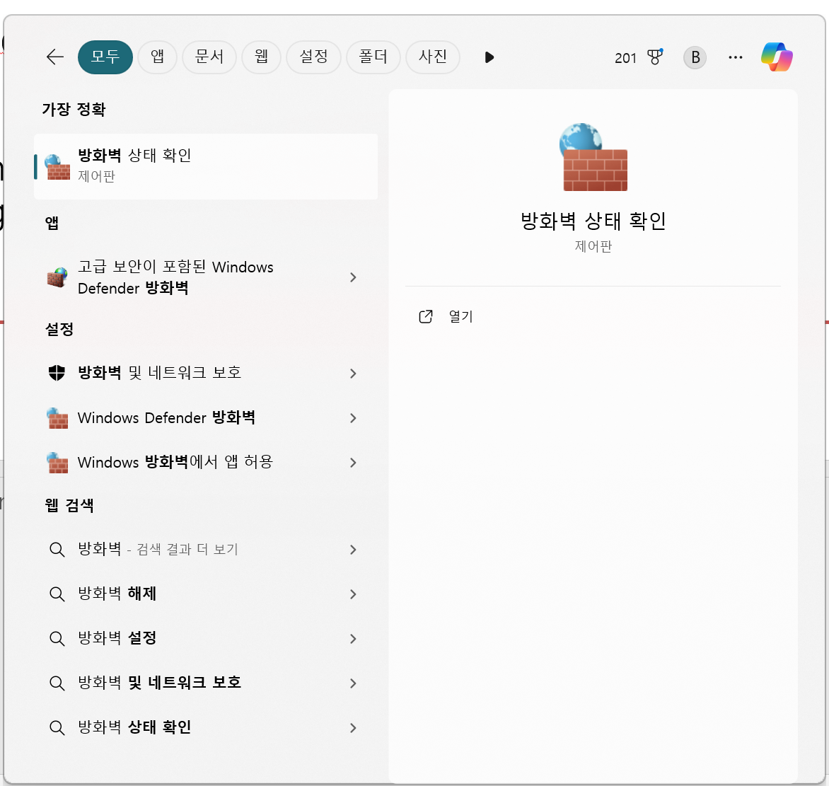
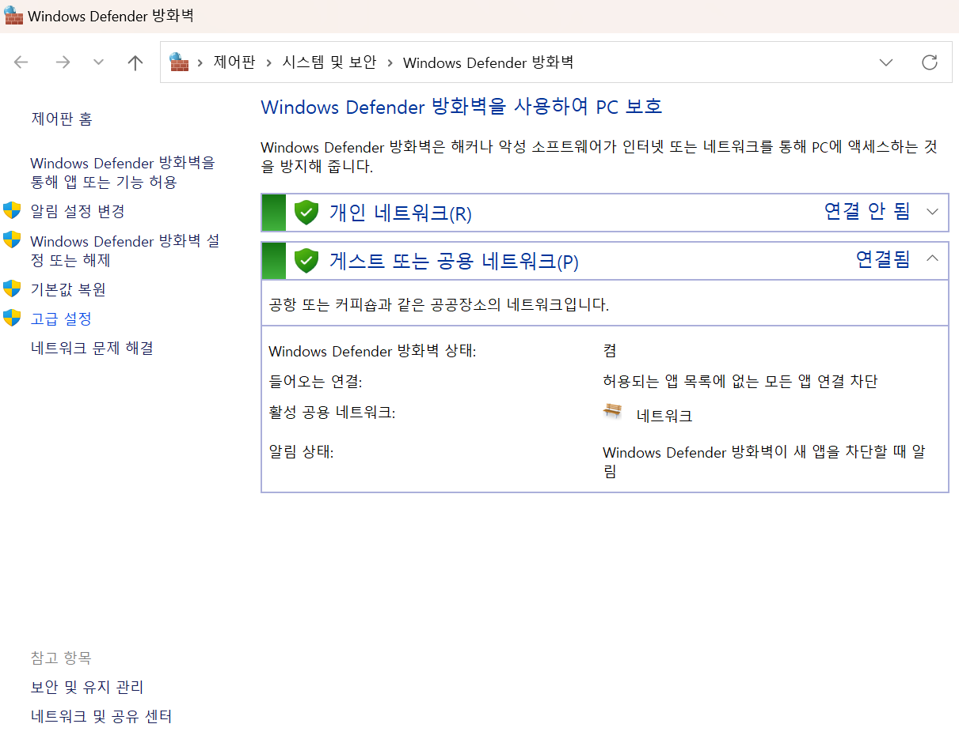
Networking
If it is not working, it may be due to the firewall
On the Bob’s computer, please allow the port number on your firewall:
Notes:
We are living in the computerized world. Now we cannot imagine the world without computers.

Slide 7
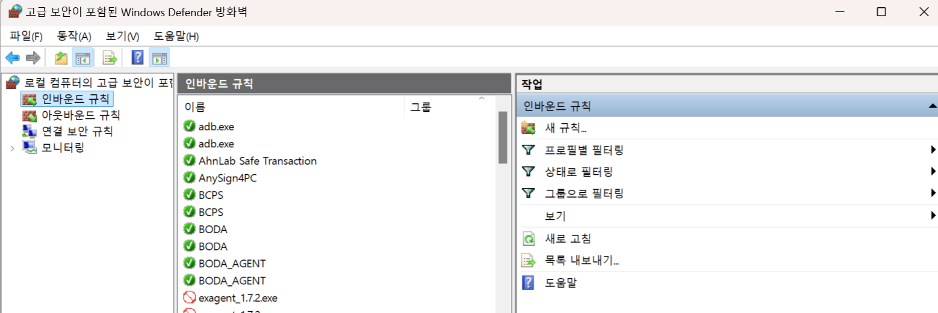
Networking
If it is not working, it may be due to the firewall
On the Bob’s computer, please allow the port number on your firewall:
Notes:
We are living in the computerized world. Now we cannot imagine the world without computers.

Slide 8
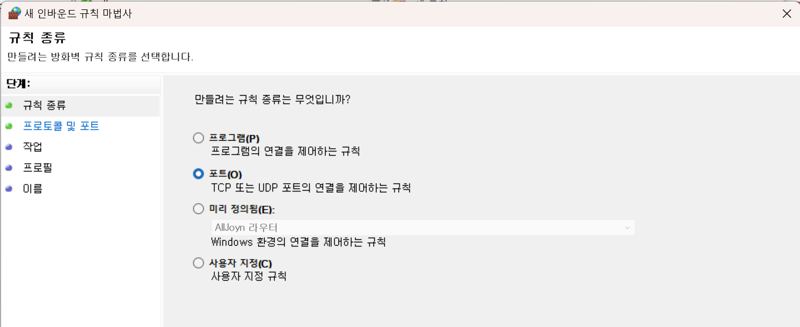
Networking
If it is not working, it may be due to the firewall
On the Bob’s computer, please allow the port number on your firewall:
Notes:
We are living in the computerized world. Now we cannot imagine the world without computers.

Slide 9
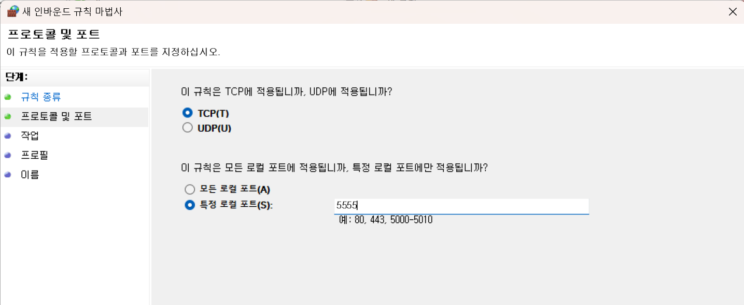
Networking
If it is not working, it may be due to the firewall
On the Bob’s computer, please allow the port number on your firewall:
Notes:
We are living in the computerized world. Now we cannot imagine the world without computers.

Slide 10
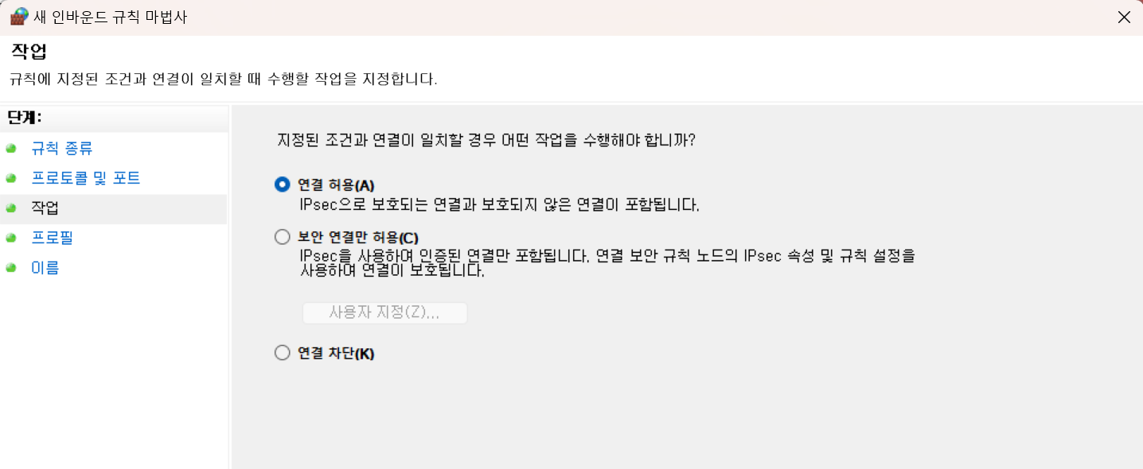
Networking
If it is not working, it may be due to the firewall
On the Bob’s computer, please allow the port number on your firewall:
Notes:
We are living in the computerized world. Now we cannot imagine the world without computers.

Slide 11
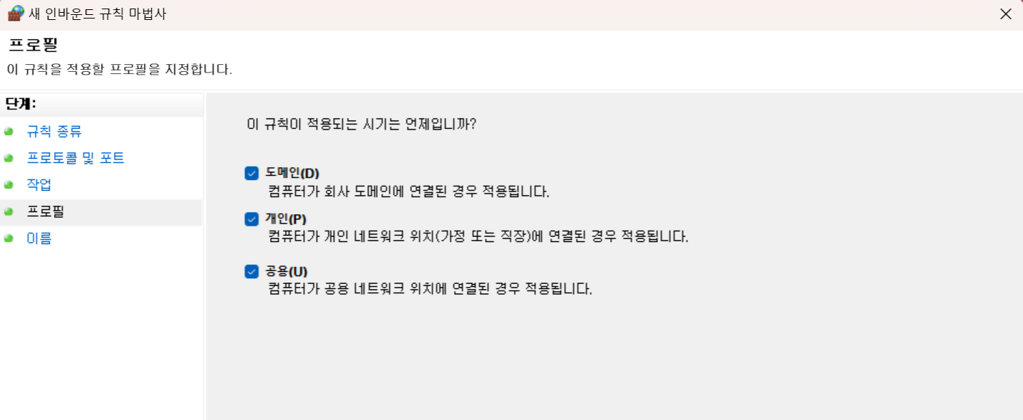
Networking
If it is not working, it may be due to the firewall
On the Bob’s computer, please allow the port number on your firewall:
Notes:
We are living in the computerized world. Now we cannot imagine the world without computers.

Slide 12
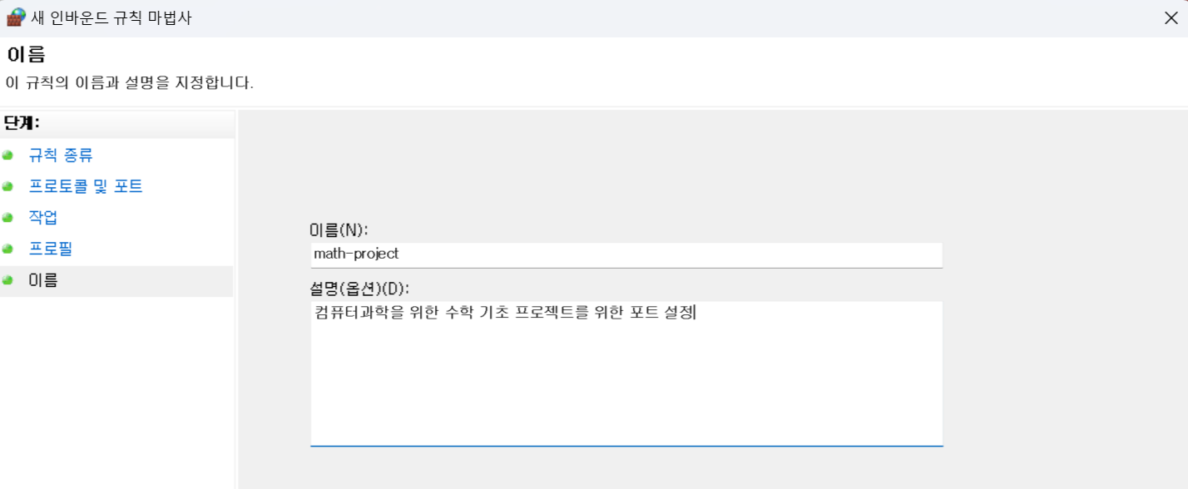
Networking
If it is not working, it may be due to the firewall
On the Bob’s computer, please allow the port number on your firewall:
Notes:
We are living in the computerized world. Now we cannot imagine the world without computers.

Slide 13
Networking
3. Revise the code to exchange custom messages
Please revise the code to exchange the messages as follows:
Hello
Hi!
Alice
Bob
Alice
I am Bob. Who are you?
Bob
Hi!, I am Alice
World
Nice to meet you, Alice
(Before)
(After)
Notes:
We are living in the computerized world. Now we cannot imagine the world without computers.

Slide 14
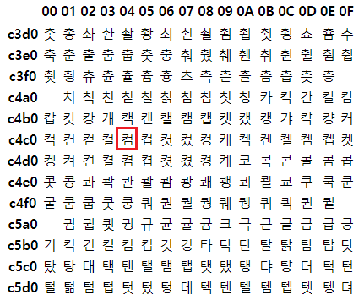
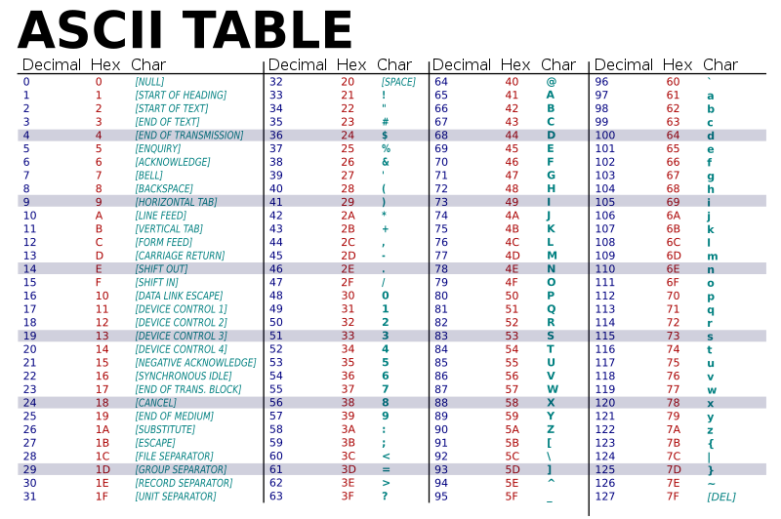
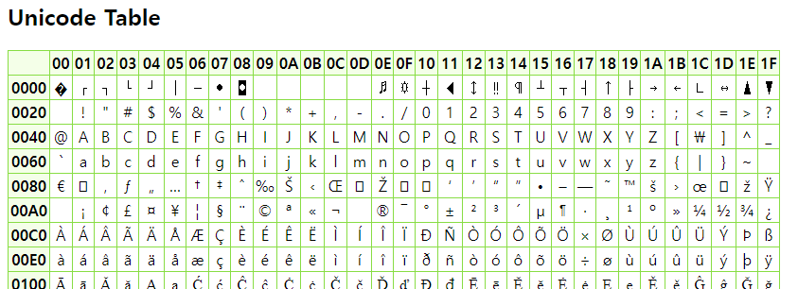
Encoding
There are a number of ways to encode texts into bytes
EUC-KR
ASCII
Unicode
Notes:
There are many codes that are used to encode texts into bytes. For instance, there are a ASCII code, an euc-kr code, and a unicode

Slide 15
JavaScript Object Notation (JSON)
A language-independent data format, defined in RFC 8259
Notes:
We are living in the computerized world. Now we cannot imagine the world without computers.

Slide 16
JavaScript Object Notation (JSON)
A language-independent data format, defined in RFC 8259
JSON uses human-readable text to express data objects consisting of attribute-value pairs:
Notes:
We are living in the computerized world. Now we cannot imagine the world without computers.

Slide 17
JavaScript Object Notation (JSON)
A language-independent data format, defined in RFC 8259
JSON uses human-readable text to express data objects consisting of attribute-value pairs:
{ ”name”: ”Smith”, “age”: 43, “son”: [“Henry”, “Robert”], “address”: {“city”: “Seoul”, “zip”: “12345”} }
Notes:
We are living in the computerized world. Now we cannot imagine the world without computers.

Slide 18
JavaScript Object Notation (JSON)
A language-independent data format, defined in RFC 8259
JSON uses human-readable text to express data objects consisting of attribute-value pairs:
a JSON object starts with {
{ ”name”: ”Smith”, “age”: 43, “son”: [“Henry”, “Robert”], “address”: {“city”: “Seoul”, “zip”: “12345”} }
a JSON object ends with }
Notes:
We are living in the computerized world. Now we cannot imagine the world without computers.

Slide 19
JavaScript Object Notation (JSON)
A language-independent data format, defined in RFC 8259
JSON uses human-readable text to express data objects consisting of attribute-value pairs:
a JSON object starts with {
{ ”name”: ”Smith”, “age”: 43, “son”: [“Henry”, “Robert”], “address”: {“city”: “Seoul”, “zip”: “12345”} }
delimiter for pairs
delimiter for pairs
delimiter for pairs
a JSON object ends with }
Notes:
We are living in the computerized world. Now we cannot imagine the world without computers.

Slide 20
JavaScript Object Notation (JSON)
A language-independent data format, defined in RFC 8259
JSON uses human-readable text to express data objects consisting of attribute-value pairs:
{ ”name”: ”Smith”, “age”: 43, “son”: [“Henry”, “Robert”], “address”: {“city”: “Seoul”, “zip”: “12345”} }
an attribute (or a key)
an attribute (or a key)
an attribute (or a key)
an attribute (or a key)
Notes:
We are living in the computerized world. Now we cannot imagine the world without computers.

Slide 21
JavaScript Object Notation (JSON)
A language-independent data format, defined in RFC 8259
JSON uses human-readable text to express data objects consisting of attribute-value pairs:
a value for
”name” (string)
a value for “age” (int)
a value for “son” (list)
a value for “address” (JSON)
{ ”name”: ”Smith”, “age”: 43, “son”: [“Henry”, “Robert”], “address”: {“city”: “Seoul”, “zip”: “12345”} }
an attribute (or a key)
an attribute (or a key)
an attribute (or a key)
an attribute (or a key)
Notes:
We are living in the computerized world. Now we cannot imagine the world without computers.

Slide 22
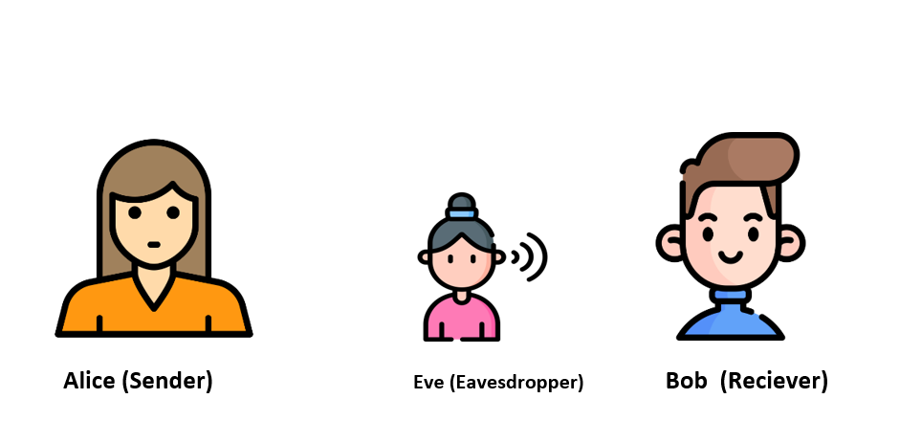
Networking with Structured Data
The JSON format is typically used to exchange the data on the Internet
Run
Run
{“name”: “Alice”, “age”: 20}
{“name”: “Bob”, “age”: 21, “address”: {“country”: “Korea”, “city”: “Seoul”}}
Alice
Bob
Please refer to examples/json_alice.py and examples/json_bob.py

Slide 23
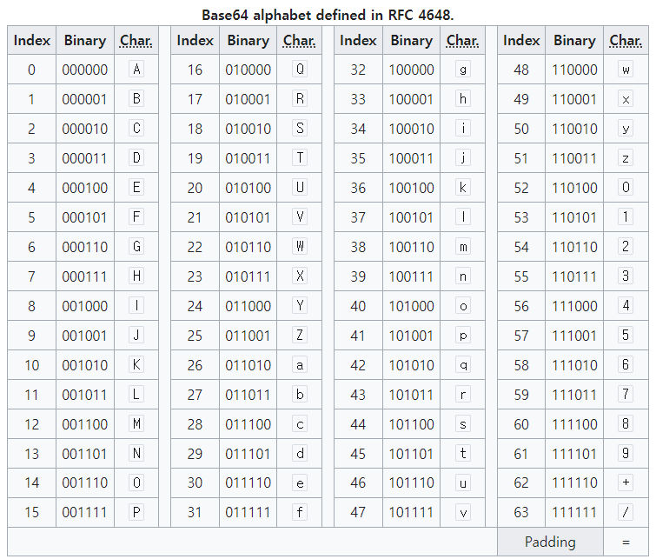
Base64 Encoding
The particular set of 64 characters that are common to most encodings and that are also printable
Notes:
We are living in the computerized world. Now we cannot imagine the world without computers.

Slide 24
Networking with Base64-Structured Data
The Base64 encoding is typically used to exchange the data in a printable way
Run
Run
{“name”: “Alice”, “random”: …}
{“name”: “Bob”, “random”: …}
Alice
Bob
Please refer to examples/base64_alice.py and examples/base64_bob.py

Slide 25


Advanced Encryption Standard (AES)
AES is a symmetric block cipher to encrypt/decrypt messages based on a shared symmetric key
Message
Message
Encrypt with
Decrypt with
Eve
Alice
Bob
The attacker can monitor all communication between Alice and Bob

Slide 26
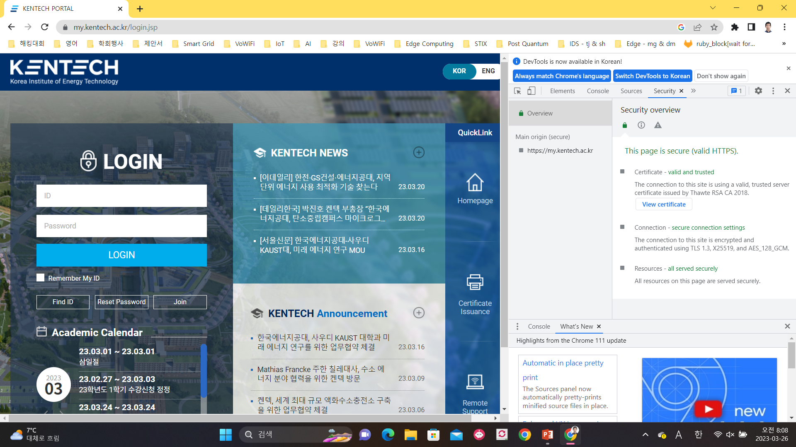
Advanced Encryption Standard (AES)
Notes:
We are living in the computerized world. Now we cannot imagine the world without computers.

Slide 27
State
SubBytes
S
S
S
S
S
S
S
S
S
S
S
S
S
S
S
S
State
ShiftRows
State
MixColumns
M
M
M
M
State
$$r_{0}$$
$$r_{1}$$
$$r_{2}$$
$$r_{3}$$
$$r_{4}$$
$$r_{5}$$
$$r_{6}$$
$$r_{7}$$
$$r_{8}$$
$$r_{9}$$
$$r_{10}$$
$$r_{11}$$
$$r_{12}$$
$$r_{13}$$
$$r_{14}$$
$$r_{15}$$
AddRoundKey
State
Notes:
We are living in the computerized world. Now we cannot imagine the world without computers.

Slide 28
Networking with AES
We will only use AES-ECB 256-bit in our project
Run
Run with a message
{“name”: “Alice”, “random”: … (256 bit)}
Decode the base64-encoded random number
Encrypt the message with the random number as a key
Encode the encryption in Base64
{“name”: “Bob”, “encryption”: …}
You must install pycrypto by:
pip3 install pycrypto
Alice
Bob
Please refer to examples/aes_alice.py and examples/aes_bob.py

